Slide 1
On Fine-Grained Distinct Element Estimation
Ilias Diakonikolas
Daniel M. Kane
Jasper C.H. Lee
Thanasis Pittas
David P. Woodruff
Samson Zhou

Slide 2

Distinct Elements
$α$ servers
Server $i$ has a set $S_{i}⊆[1,2,3,…,n]$
$S=\bigcup_{i}{S_{i}}$
Number of distinct elements in dataset is $F_{0}\left(S\right)={\left\|S\right\|}_{0}=\left|S\right|$

Slide 3
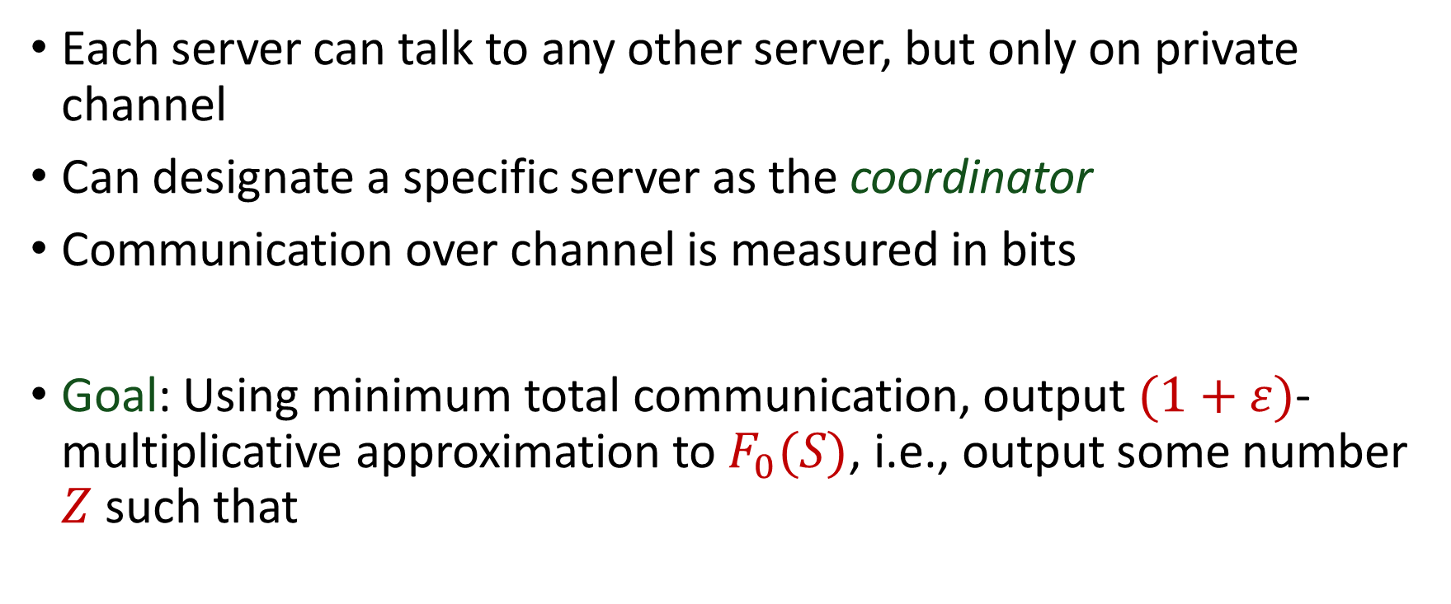
Communication Model
Each server can talk to any other server, but only on private channel
Can designate a specific server as the coordinator
Communication over channel is measured in bits
Goal: Using minimum total communication, output $(1+ε)$-multiplicative approximation to $F_{0}(S)$, i.e., output some number $Z$ such that
$$Z≤F_{0}\left(S\right)≤\left(1+ε\right)⋅Z$$

Slide 4
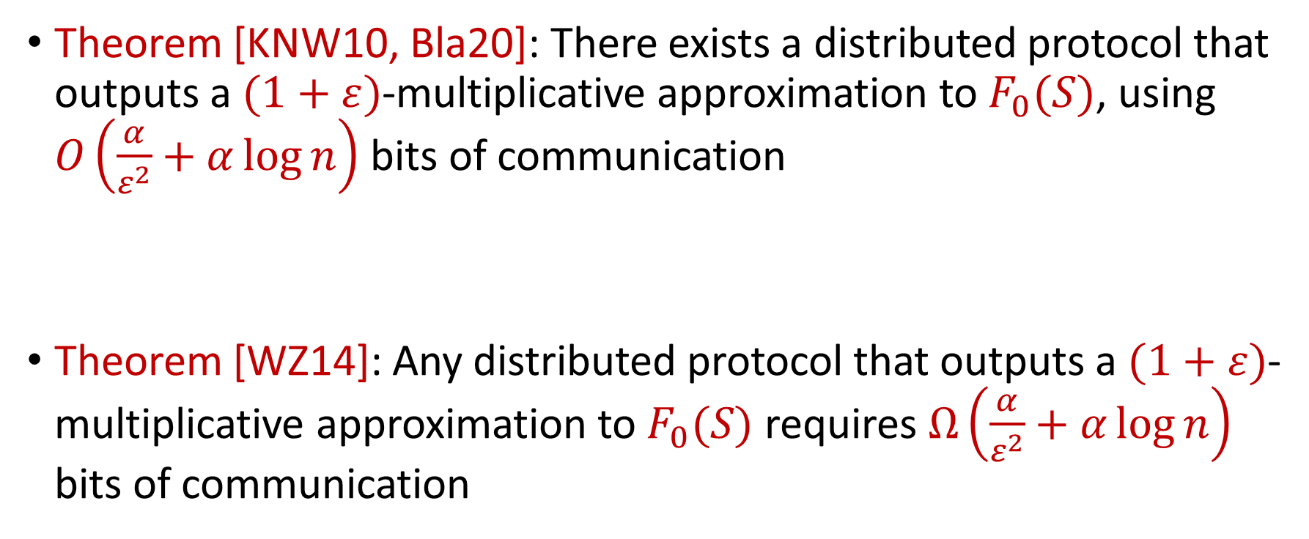
Previous Results
Theorem [KNW10, Bla20]: There exists a distributed protocol that outputs a $(1+ε)$-multiplicative approximation to $F_{0}(S)$, using $O\left(\frac{α}{ε^{2}}+α\log{n}\right)$ bits of communication
Theorem [WZ14]: Any distributed protocol that outputs a $(1+ε)$-multiplicative approximation to $F_{0}(S)$ requires $Ω\left(\frac{α}{ε^{2}}+α\log{n}\right)$ bits of communication

Slide 5
Bridging Theory and Practice
There is usually a large number of servers and we want good accuracy, so this means we should require a lot of communication!
Algorithms behave well in practice with little communication
What’s going on?

Slide 6
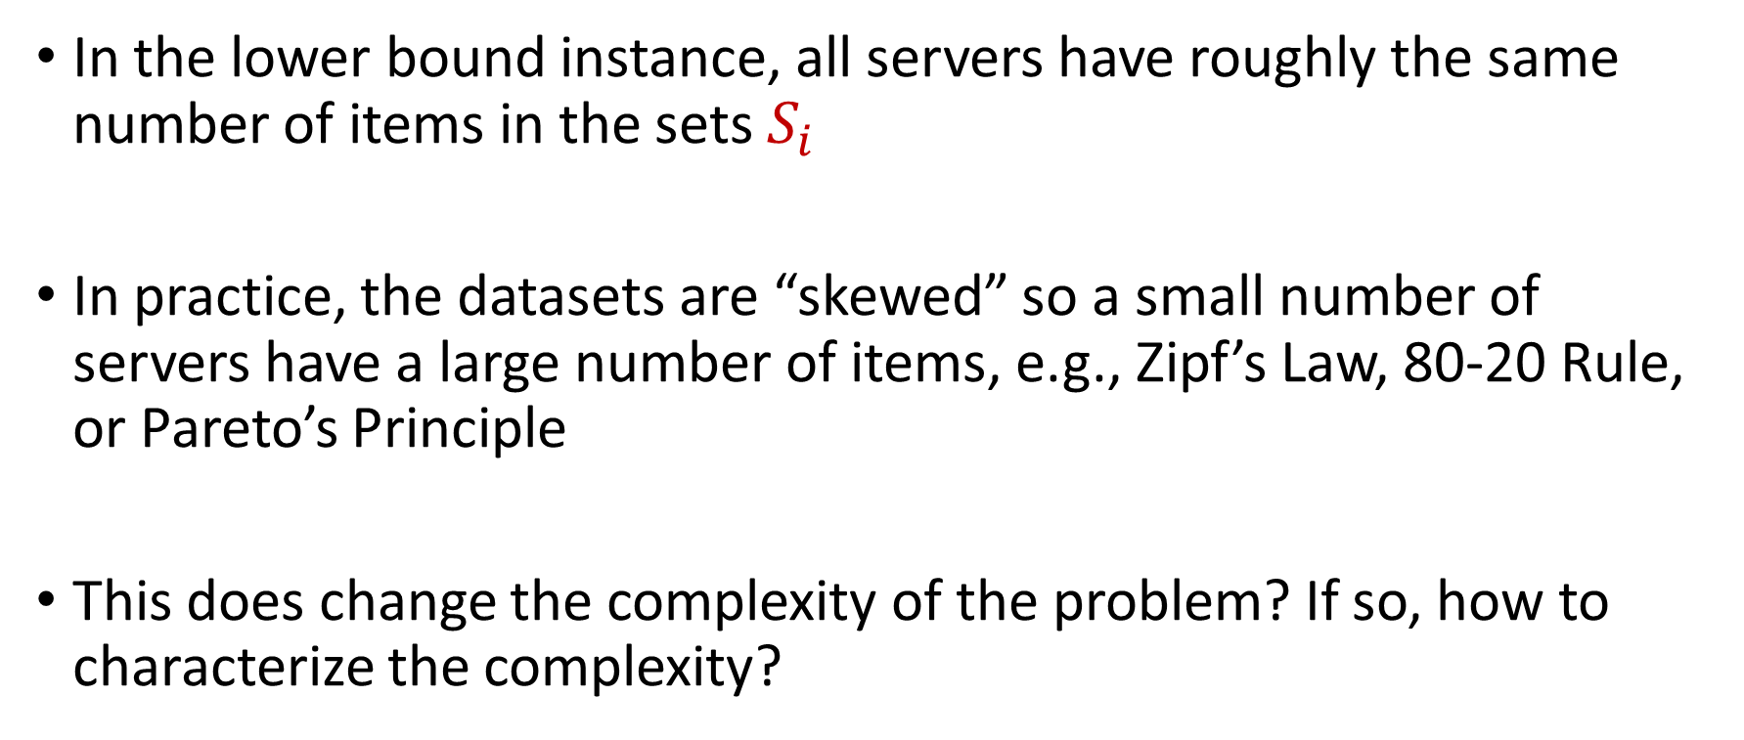
Our Observations
In the lower bound instance, all servers have roughly the same number of items in the sets $S_{i}$
In practice, the datasets are “skewed” so a small number of servers have a large number of items, e.g., Zipf’s Law, 80-20 Rule, or Pareto’s Principle
This does change the complexity of the problem? If so, how to characterize the complexity?

Slide 7
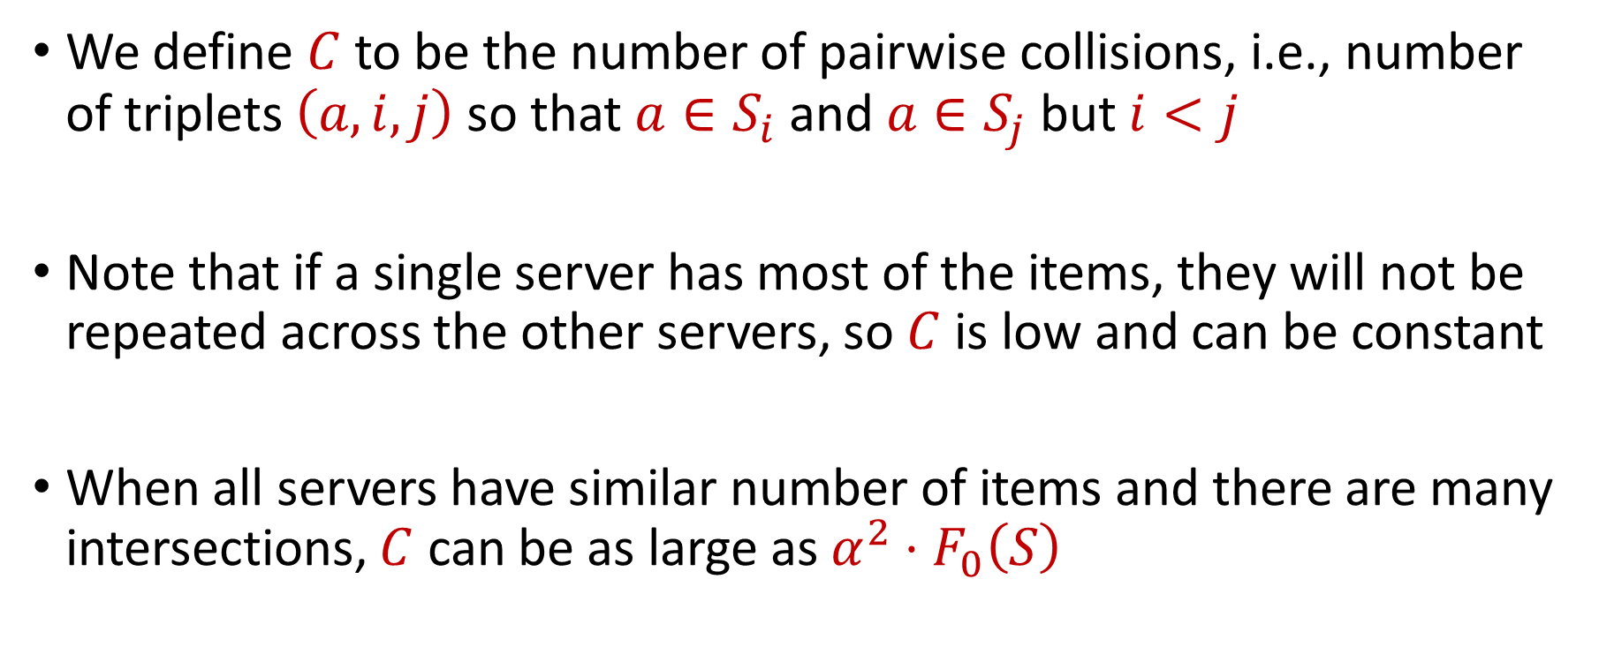
New Parameterization: Pairwise Collisions
We define $C$ to be the number of pairwise collisions, i.e., number of triplets $\left(a,i,j\right)$ so that $a∈S_{i}$ and $a∈S_{j}$ but $i<j$
Note that if a single server has most of the items, they will not be repeated across the other servers, so $C$ is low and can be constant
When all servers have similar number of items and there are many intersections, $C$ can be as large as $α^{2}⋅F_{0}\left(S\right)$

Slide 8
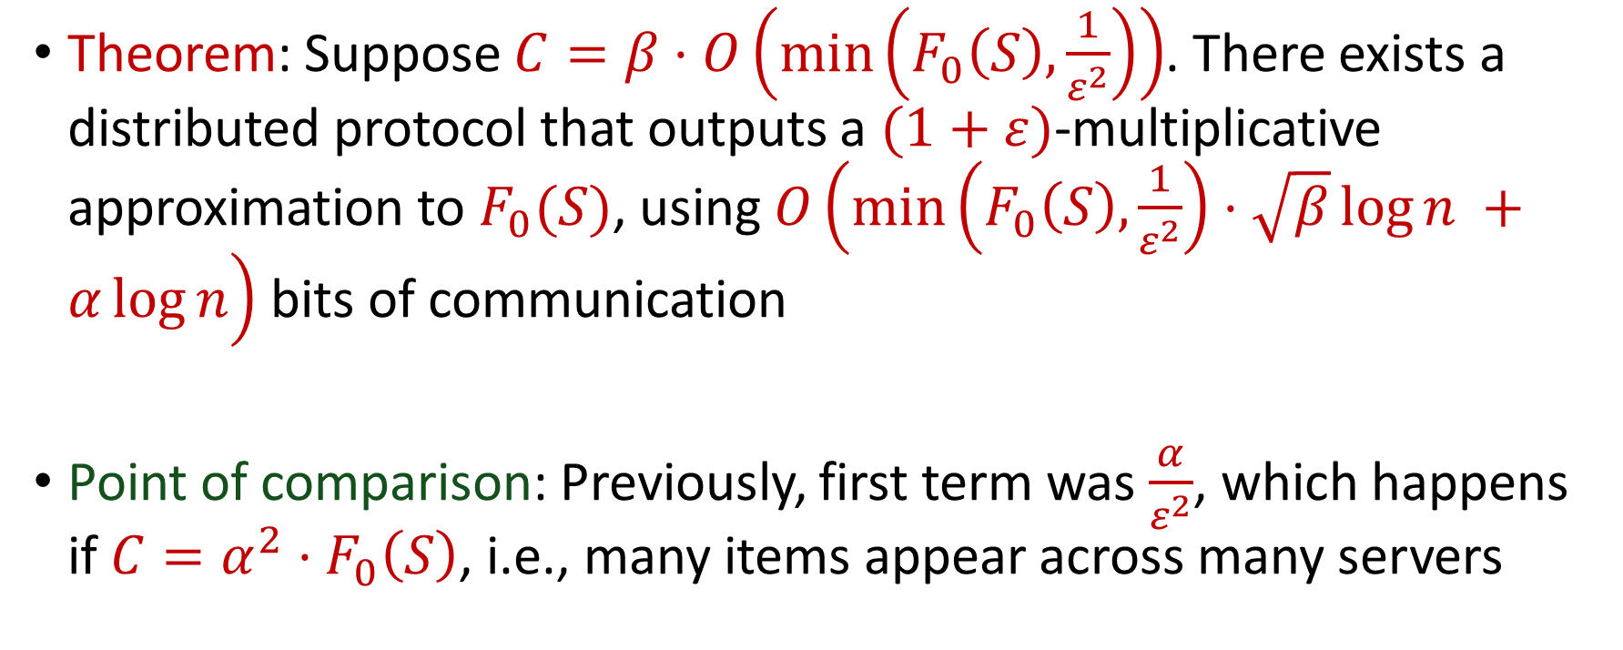
Our Results
Theorem: Suppose $C=β⋅O\left(\min\left(F_{0}\left(S\right),\frac{1}{ε^{2}}\right)\right)$. There exists a distributed protocol that outputs a $(1+ε)$-multiplicative approximation to $F_{0}(S)$, using $O\left(\min\left(F_{0}\left(S\right),\frac{1}{ε^{2}}\right)⋅\sqrt{β}\log{n }+α\log{n}\right)$ bits of communication
Point of comparison: Previously, first term was $\frac{α}{ε^{2}}$, which happens if $C=α^{2}⋅F_{0}\left(S\right)$, i.e., many items appear across many servers

Slide 9
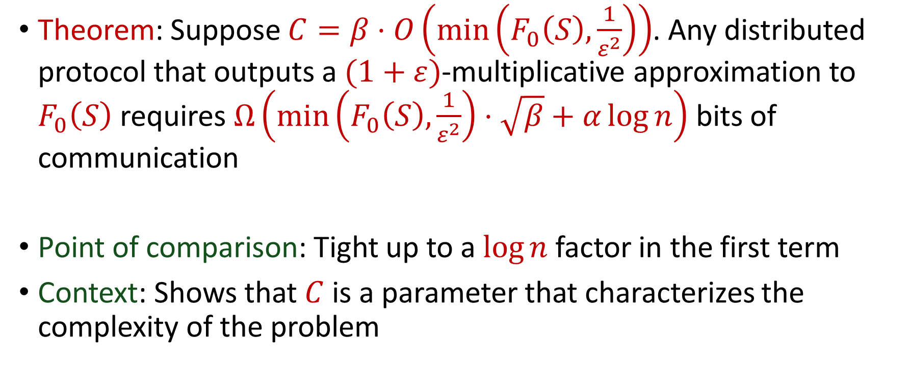
Our Results
Theorem: Suppose $C=β⋅O\left(\min\left(F_{0}\left(S\right),\frac{1}{ε^{2}}\right)\right)$. Any distributed protocol that outputs a $(1+ε)$-multiplicative approximation to $F_{0}\left(S\right)$ requires $Ω\left(\min\left(F_{0}\left(S\right),\frac{1}{ε^{2}}\right)⋅\sqrt{β}+α\log{n}\right)$ bits of communication
Point of comparison: Tight up to a $\log{n}$ factor in the first term
Context: Shows that $C$ is a parameter that characterizes the complexity of the problem

Slide 10
